Slide 1

Dominance Matrices in AFL
Michael Le

Slide 2
Introduction
The aim of this assessment is to apply two different methods of dominance matrices to compare the data of AFL teams matches to the rankings from the AFL Season Leader for 2022. To determine whether dominance matrices produces accurate predictions according from Roger Walter’s article “Dominance Matrices: Your Secret Weapon in Footy Tipping”. (check referencing style from the discussion)

Slide 3
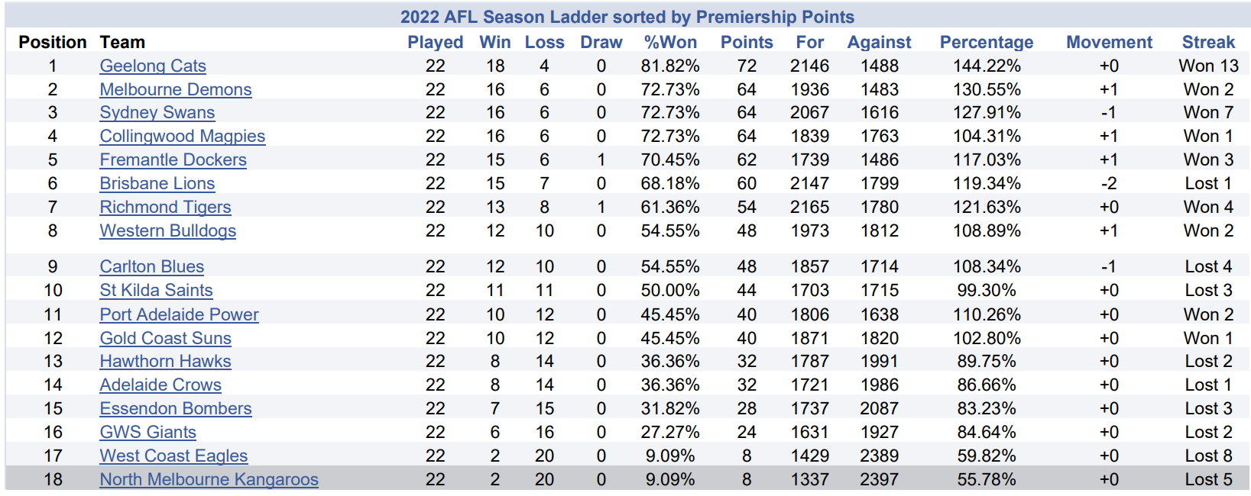
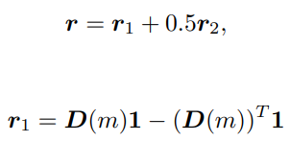

Problem Statement
To achieve this, we have to modify or optimize the best appropriate formulae for r determines the rank which consists of adding first, second and higher order in terms of r_m for some m (see Fig 2.). Where r_m measures the difference of how good and bad the teams performed depends on their ratios or points gained. If the teams played each other at least one time we average the values for the ratio-scores and win-loss methods. My choices of values of m after the number of rounds, I have selected m=10,m=15,m=19 and m=22. To figure out patterns if there is some luck and skill factors involved that could impact their overall rankings that played up to that particular round compared to the actual ranking after 23 rounds (see Fig 1. ).
Fig 1. AFL ladder after 23 rounds
Fig 2. Formulae used to determine rankings

Slide 4
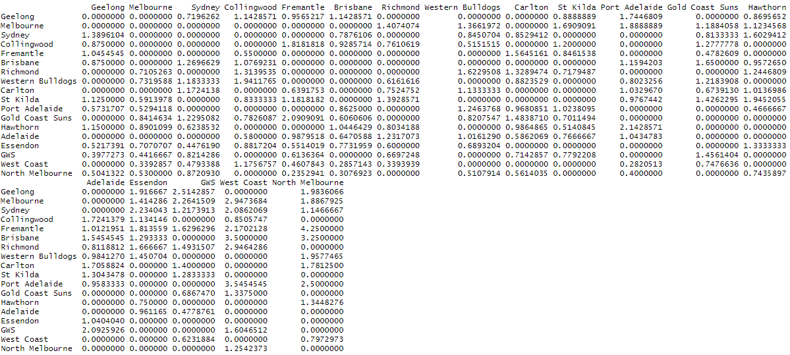
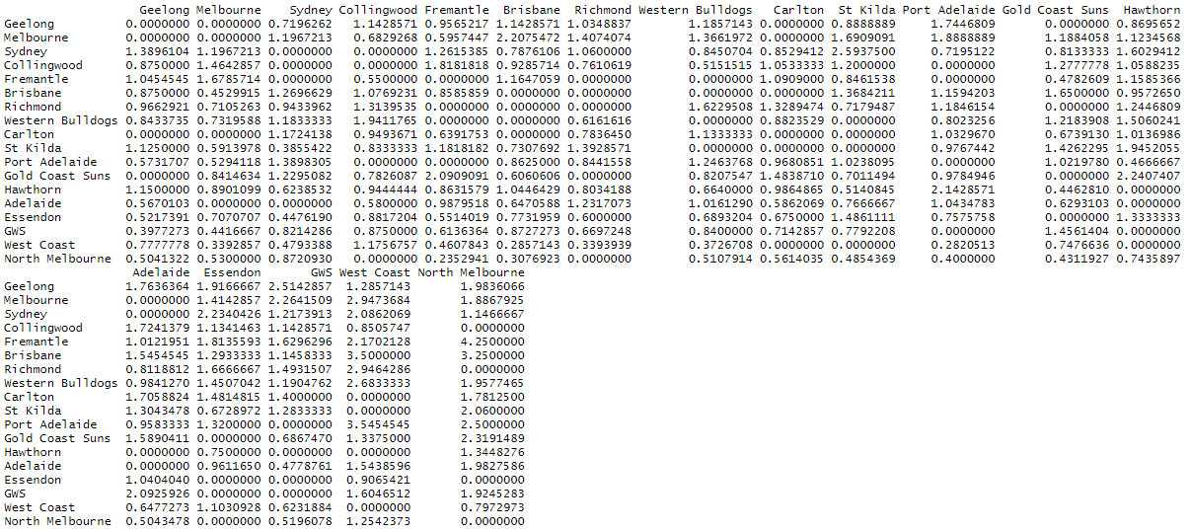
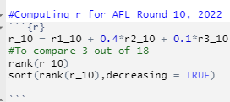
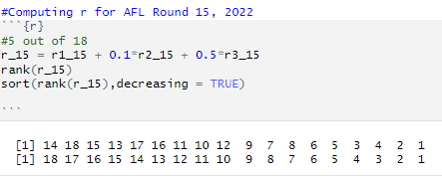
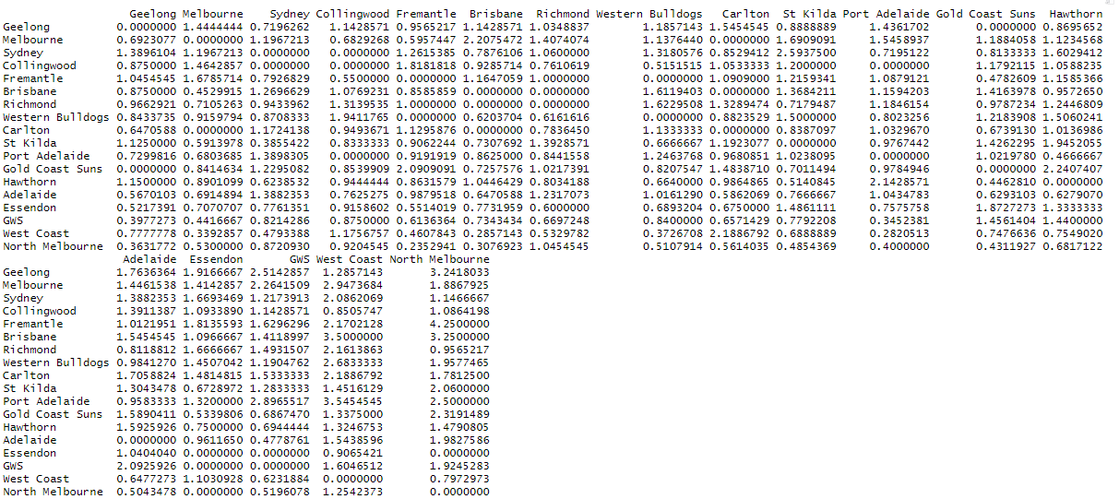
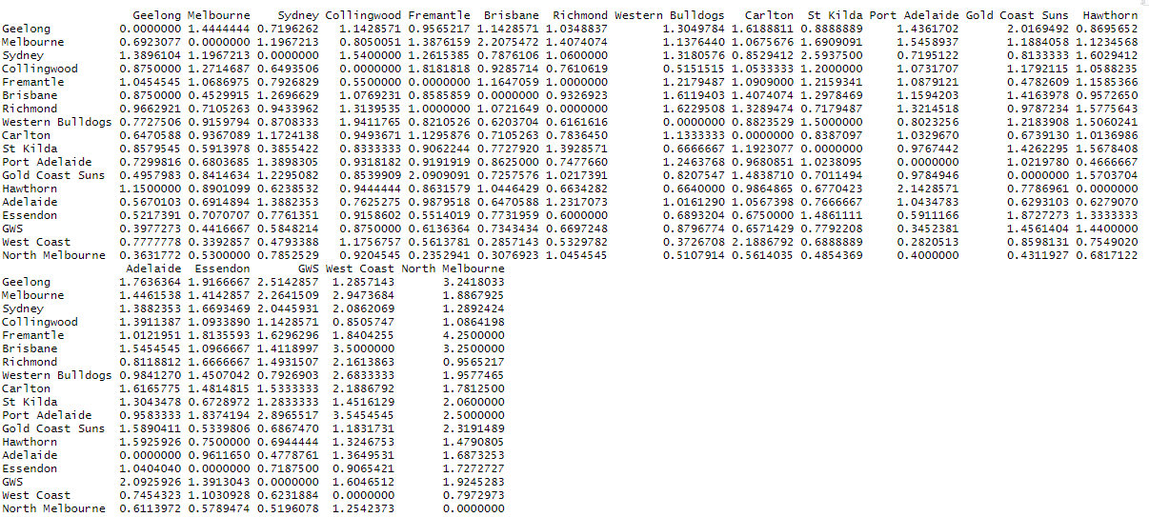
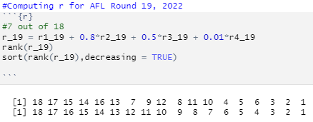
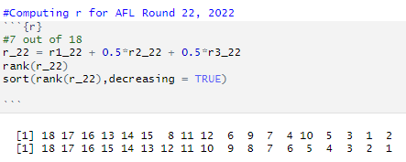
Report findings using Ratio-Scores
NOTE: Using R-Studio expm package to compute nicer matrix multiplication. Rank from highest from lowest, descending order.

Slide 5
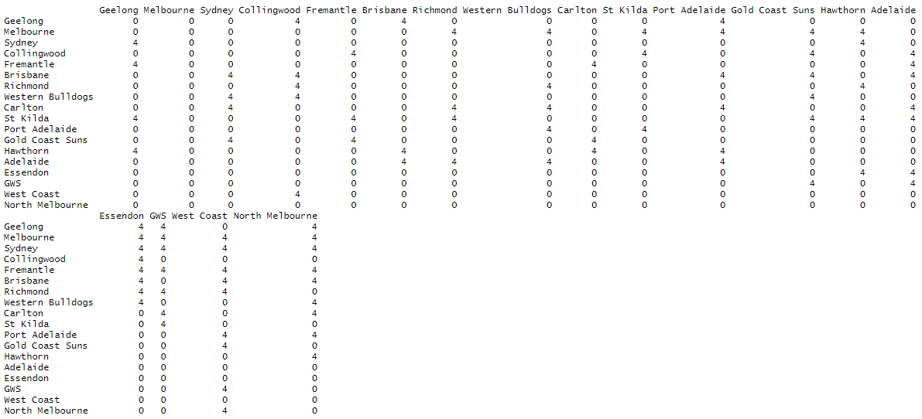
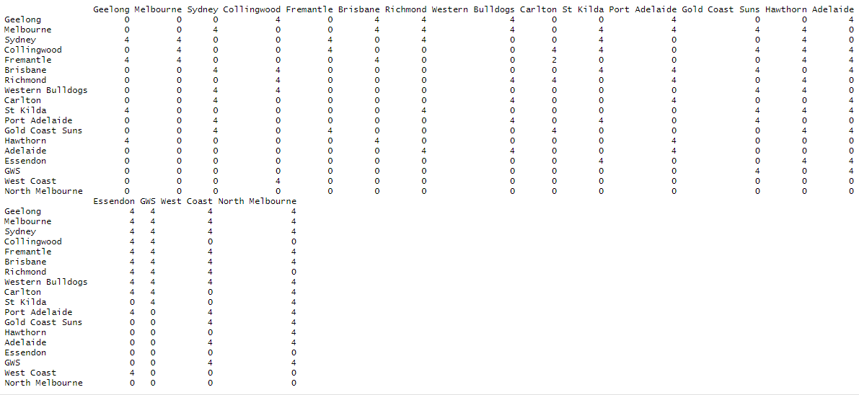
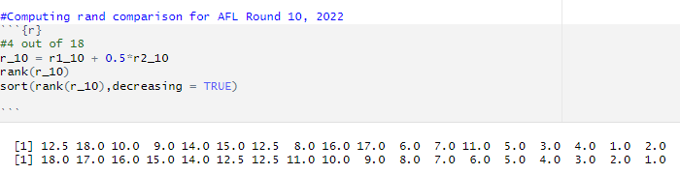
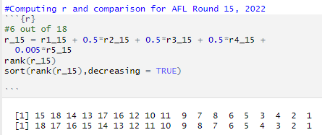
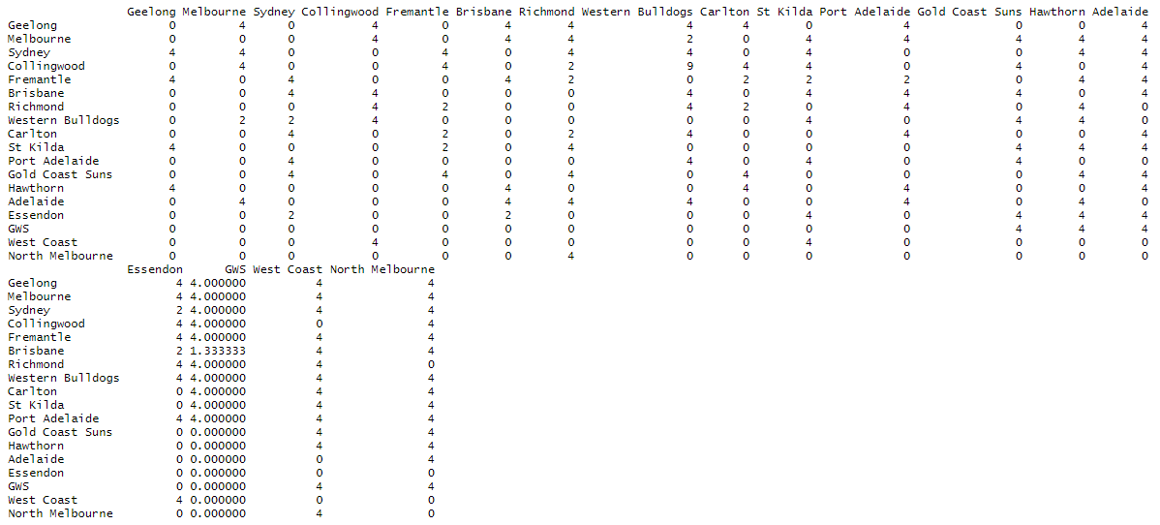
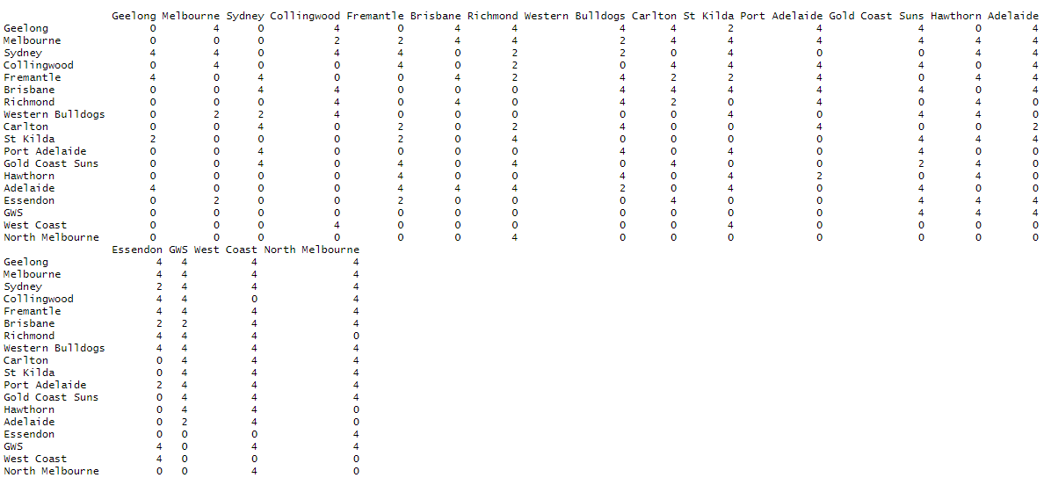
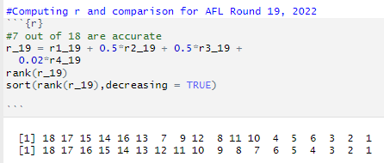
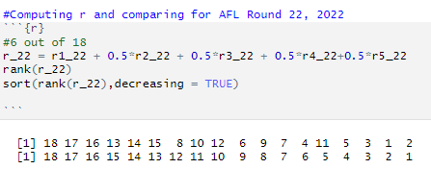
Report Findings using Win-loss Method
NOTE: Using R-Studio expm package to compute nicer matrix multiplication. Rank from highest from lowest, descending order.

Slide 6
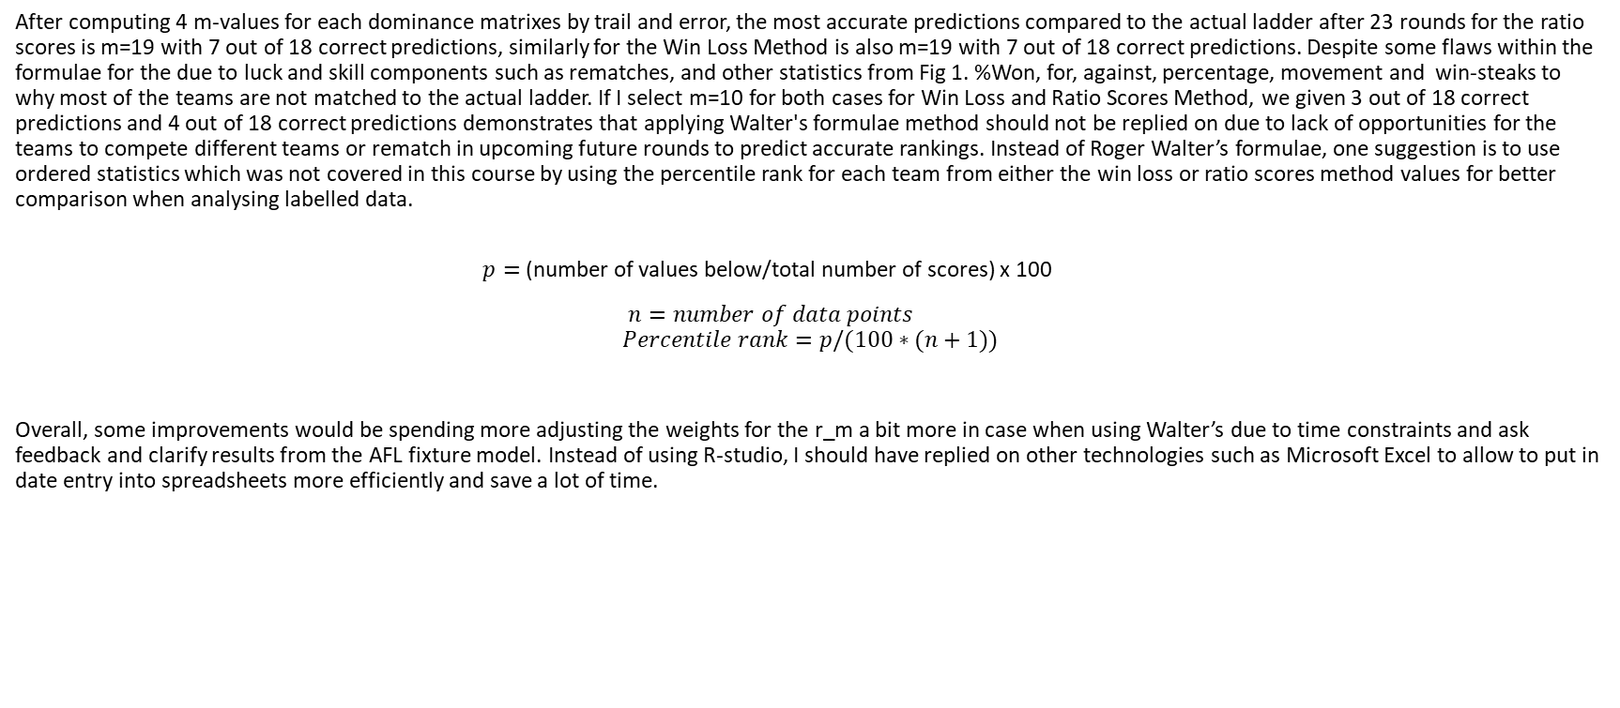
Analysis of Data and Conclusion
After computing 4 m-values for each dominance matrixes by trail and error, the most accurate predictions compared to the actual ladder after 23 rounds for the ratio scores is m=19 with 7 out of 18 correct predictions, similarly for the Win Loss Method is also m=19 with 7 out of 18 correct predictions. Despite some flaws within the formulae for the due to luck and skill components such as rematches, and other statistics from Fig 1. %Won, for, against, percentage, movement and win-steaks to why most of the teams are not matched to the actual ladder. If I select m=10 for both cases for Win Loss and Ratio Scores Method, we given 3 out of 18 correct predictions and 4 out of 18 correct predictions demonstrates that applying Walter's formulae method should not be replied on due to lack of opportunities for the teams to compete different teams or rematch in upcoming future rounds to predict accurate rankings. Instead of Roger Walter’s formulae, one suggestion is to use ordered statistics which was not covered in this course by using the percentile rank for each team from either the win loss or ratio scores method values for better comparison when analysing labelled data.
$p=$(number of values below/total number of scores) x 100
$n=number of data points$
$$Percentile rank=p/(100∗(n+1))$$
Overall, some improvements would be spending more adjusting the weights for the r_m a bit more in case when using Walter’s due to time constraints and ask feedback and clarify results from the AFL fixture model. Instead of using R-studio, I should have replied on other technologies such as Microsoft Excel to allow to put in date entry into spreadsheets more efficiently and save a lot of time.

Slide 7
End of Presentation

Slide 8
References
Walter, R. (2011). Dominance matrices: Your secret weapon in footy tipping. Vinculum, 48(2), 8–9..
Indeed Editorial Team (2023). How To Calculate Percentile Rank (With Example) | Indeed.com

